Slide 1
Mining the Search Trails of Surfing Crowds: Identifying Relevant Websites from User Activity Data
Misha Bilenko and Ryen White
presented by Matt Richardson
Microsoft Research

Slide 2
Search = Modeling User Behavior
Retrieval functions estimate relevance from behavior of several user groups:
Page authors create page contents
TF-IDF/BM25, query-is-page-title, …
Page authors create links
PageRank/HITS, query-matches-anchor text, …
Searchers submit queries and click on results
Clickthrough, query reformulations
Most user behavior occurs beyond search engines
Viewing results and browsing beyond them
What can we capture, and how can we use it?

Slide 3
Prior Work
Clickthrough/implicit feedback methods
Learning ranking functions from clicks and query chains [Joachims ‘02, Xue et al. ‘04, Radlinski-Joachims ’05 ‘06 ‘07]
Combining clickthrough with traditional IR features [Richardson et al. ‘06, Agichtein et al. ‘06]
Activity-based user models for personalization
[Shen et al. ‘05, Tan et al. ’06]
Modeling browsing behavior
[Anderson et al. ‘01, Downey et al. ‘07, Pandit-Olston ’07]

Slide 4
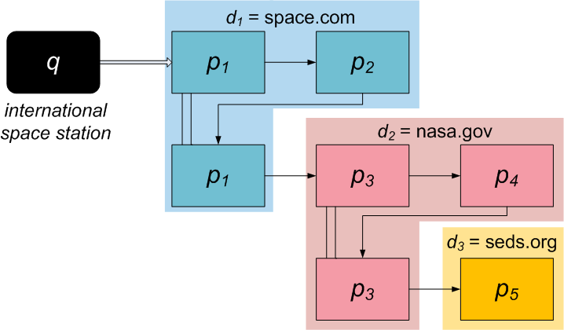
Search Trails
Trails start with a search engine query
Continue until a terminating event
Another search
Visit to an unrelated site (social networks, webmail)
Timeout, browser homepage, browser closing
Notes:
A combination of searching and browsing behavior can be represented by search trails that users follow after submitting a search engine query. Trails start with a query and continue until an event like another search or a visit to an unrelated service like webmail. Here is an example of a trail where after submitting the initial query a user visits pages in several domains. Browsing behavior like hitting the “back” button and spending some time on each page is captured by trails. A natural question is what does this buy us beyond just looking at search engine logs. First of all, it provides us a view that is unbiased by our own search results, since more than 80% of trails originate at other search engines. Trails also capture dwell time, thus reflecting both the attention share and pageview count, two primary metrics for website popularity. Finally, trails allow us to go beyond search result pages, telling us what pages *really* satisfy information needs.

Slide 5
Trails vs. Click logs
Trails capture dwell time
Both attention share and pageview counts are accounted
Trails represent user activity across many websites
Browsing sequences surface “under-ranked” pages
Click logs are less noisy
Position bias is easy to control

Slide 6
Predicting Relevance from Trails
Task: given a trails corpus D ={q_{i} → (d_{i1},…,d_{ik})}
predict relevant websites for a new query q
Trails give us the good pages for each query…
…can’t we just lookup the pages for new queries?
Not directly: 50+% of queries are unique
Page visits are also extremely sparse
Solutions:
Query sparsity: term-based matching, language modeling
Pageview sparsity: smoothing (domain-level prediction)

Slide 7
Model 1: Heuristic
Documents ≈ websites
Contents ≈ queries preceding websites in trails
Split queries into terms, compute frequencies
Terms include unigrams, bigrams, named entities
Relevance is analogous to BM25 (TF-IDF)
Query-term frequency (QF) and inverse query frequency (IQF) terms incorporate corpus statistics and website popularity.

Slide 8
Model 2: Probabilistic
IR via language modeling [Zhai-Lafferty, Lavrenko]
Query-term distribution gives more mass to rare terms:
Term-website weights combine dwell time and counts

Slide 9
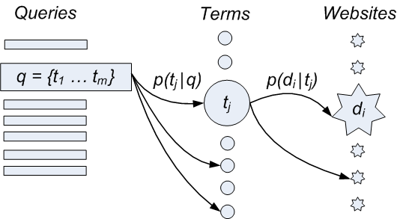
Model 2: Probabilistic (cont.)
Basic probabilistic model is noisy
Misspellings, synonyms, sparseness

Slide 10
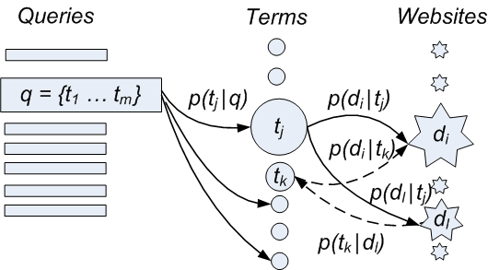
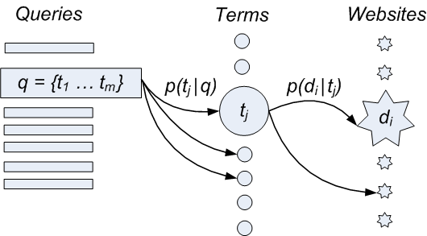
Model 3: Random Walks
Basic probabilistic model is noisy
Misspellings, synonyms, sparseness
Solution: random walk extension

Slide 11
Evaluation
Train: 140+ million search trails (toolbar data)
Test: human-labeled relevance set, 33K queries
q =[black diamond carabiners]
URL | Rating
www.bdel.com/gear | Perfect
www.climbing.com/Reviews/biners/Black_Diamond.html | Excellent
www.climbinggear.com/products/listing/item7588.asp | Good
www.rei.com/product/471041 | Good
www.nextag.com/BLACK-DIAMOND/ | Fair
www.blackdiamondranch.com/ | Bad

Slide 12
Evaluation (cont.)
Metric: NDCG (Normalized Discounted Cumulative Gain)
Preferable to MAP, Kendall’s Tau, Spearman’s, etc.
Sensitive to top-ranked results
Handles variable number of results/target items
Well correlated with user satisfaction [Bompada et al. ‘07]

Slide 13
Evaluation (cont.)
Metric: NDCG (Normalized Discounted Cumulative Gain)
Perfect ranking
Obtained ranking
i | d | r(i) | DCG_{perfect}(i)
1 | d₁ | 5 | 31
2 | d₂ | 4 | 40.5
3 | d₃ | 4 | 48.0
4 | d₄ | 3 | 51.0
5 | d₅ | 1 | 51.4
i | d | r(i) | DCG(i) | NDCG(i)
1 | d₁ | 5 | 31 | 1
2 | d₇ | 0 | 31 | 0.766
3 | d₄ | 3 | 34.5 | 0.719
4 | d₅ | 1 | 34.9 | 0.684
5 | d₂ | 4 | 40.7 | 0.792

Slide 14
Results I: Domain ranking (cont.)
Predicting correct ranking of domains for queries

Slide 15
Results I: Domain ranking (cont.)
Full trails vs. search result clicks vs. “destinations”

Slide 16
Results I: Domain ranking (cont.)
Scoring based on dwell times vs. visitation counts

Slide 17
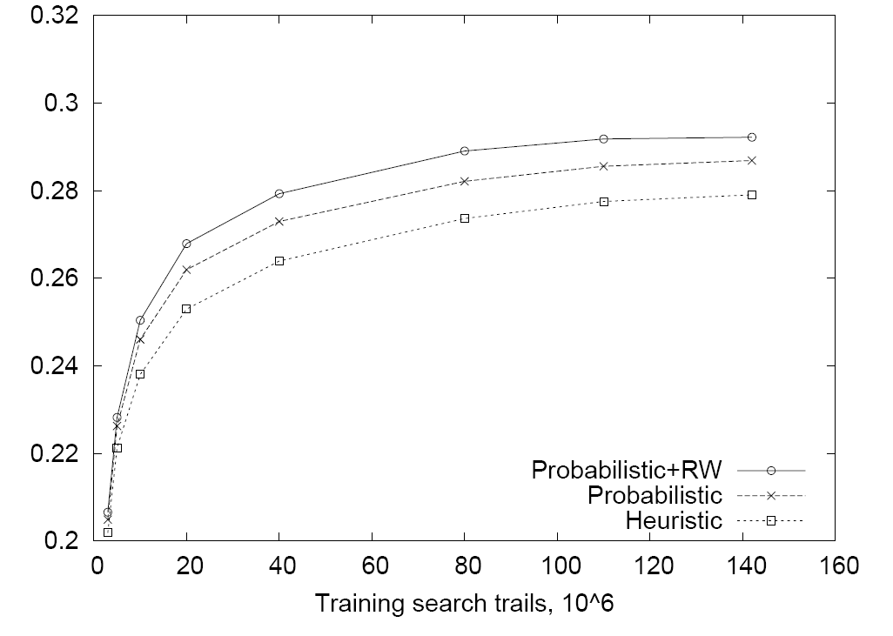
Results I: Domain ranking (cont.)
What’s better than data? LOTS OF DATA!
NDCG@10

Slide 18
Results II: Learning to Rank
Add Rel(q, d_{i}) as a feature to RankNet [Burges et al. ‘05]
Thousands of other features capture various content-, link- and clickthrough-based evidence

Slide 19
Conclusions
Post-search browsing behavior (search trails) can be mined to extract users’ implicit endorsement of relevant websites.
Trail-based relevance prediction provides unique signal not captured by other (content, link, clickthrough) features.
Using full trails outperforms using only search result clicks or search trail destinations.
Probabilistic models incorporating random walks provide best accuracy by overcoming data sparsity and noise.

Slide 20
Model 3: Random Walks (cont.)

Slide 21
URLs vs. Websites
Website ≈ domain
Sites: spaces.live.com, news.yahoo.co.uk
Not sites: www2.hp.com, cx09hz.myspace.com
Scoring:
URL ranking
Website ranking
URL | Rating
www.bdel.com/gear | Perfect
www.rei.com/product/471041 | Good
www.bdel.com/about | Fair
www.blackdiamondranch.com/ | Bad
URL | Rating
bdel.com | Perfect
rei.com | Good
blackdiamondranch.com | Bad

