Slide 1
Diagnoses, Decisions, and Outcomes:
Web Search as Decision
Support for Cancer
Michael J. Paul, Johns Hopkins University
Ryen W. White and Eric Horvitz, Microsoft Research

Slide 2

Decisions, Decisions
People frequently turn to web for decision support for health issues
  Internet is second most common information source for cancer patients
  Majority of patients who use the internet say it influenced their decisions
We seek to understand the use of Web search
as a medical decision support system
  Quality of information is known to be mixed
  Little is currently known about what patients need
  We will focus on treatment decisions
Notes:
web as decision aid – while traditional DAs are curated, people can find anything on the web, including both formal resources and informal discussions by non-experts; web is also self-directed

Slide 3

Decisions, Decisions
Focus on prostate cancer
It is the “archetypical condition" for the use of treatment decision aids
  Many different treatments with similar outcomes
  Choice often comes down to personal preference
Notes:
archetypal?

Slide 4
Contributions
Dataset creation
  Create a hierarchy of treatments and associated search terms
  Annotated corpus of 272 timelines of treatment search queries
Characterization of different phrases of treatment over time
  N-grams from search queries
  Visualizations illustrating how searches evolve over time
  Analysis of treatments searched during decision-making
Notes:
characterize different phases of treatment-related web activity over time

Slide 5
Treatment Ontology
Treatment queries range from general (“treatment options”) to specific (“low-dose radiation seed implants”)
Created a hierarchical ontology of known treatments, moving from broad categories down to detailed therapies
  after extensive review of literature on management of prostate cancer
Supports:
  Filtering for relevant logs
  Characterizing different treatment types
  Query specificity based on depth in hierarchy

Slide 6
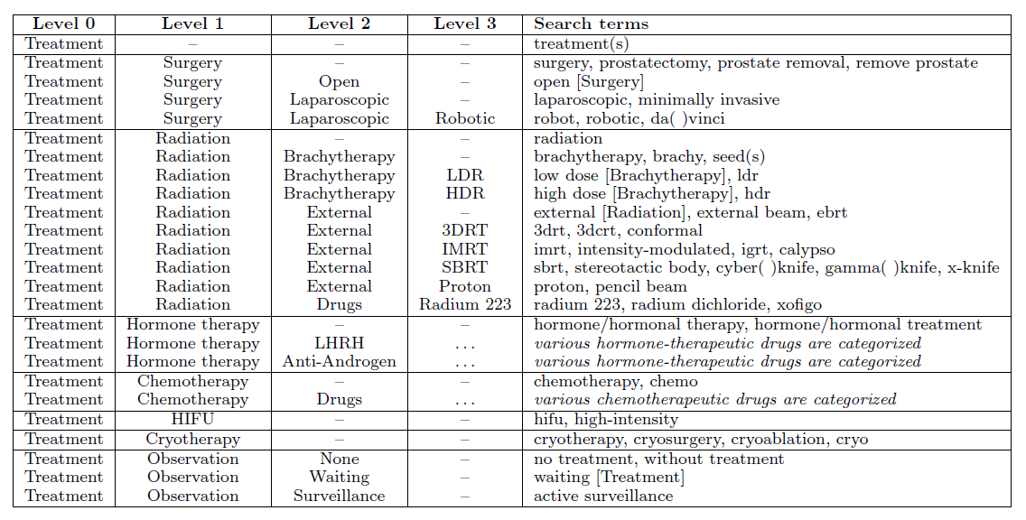
Treatment Hierarchy

Slide 7

Log Dataset
Anonymized search and browsing logs
  18 month timeframe (Mar13 – Aug14)
  Consenting users of Internet Explorer browser
  Filtered users based on:
    Searched for “prostate cancer” 3x
    Searched for a treatment-related term (given our focus)
  → 3066 search histories related to prostate cancer treatment

Slide 8
Data > Experiential vs. Exploratory
Need to identify those who were experiencing prostate cancer (experiential) vs. those who were interested in it (exploratory)
  Want to exclude healthcare professionals who search for billing codes, etc.
Determine based on an assessment of sustained and focused interest
  Sustained = long-lived after initial burst
  Focused = consumes large portion of search history
Train a classifier on set of 100 histories to identify experiential searchers (96% precision, 78% recall)
→ 1413 experiential searchers
Notes:
63% experiential

Slide 9
Data > Age Composition
Auxiliary form of validation
Expect to see older skew given distribution of prostate cancer in population
Used age references in queries
  E.g., “at/age __”, “__ year(s) old”
142 of 1413 users reported age
Compared:
  Sample = 2 mo of search logs
  Filtered = just 3x [prostate cancer]
  Expected = P(cancer|age)P(age)
    P(cancer|age) from Nat. Cancer Inst.
  High match (r = .959), esp. in older

Slide 10
Data > Treatment Timelines
We filtered the 1413 histories for those containing terms related to decision-making
  e.g. “vs”, “pros and cons”, “better”
This produced 272 search timelines
  We annotated queries with richer information
Notes:
272 contained additional search terms that indicated decision-making, so we chose to focus on those. 272 is a small enough number to annotate manually

Slide 11
Data > Annotation of Treatment Timelines
Queries annotated per deliberation and treatment stage
Deliberation
  Decision = help searchers decide between or learn about treatment options
  Preparation = about scheduled treatment
  Post-treatment = after treatment commenced or completed
Treatment stage
  Initial = first round treatment, typically surgery or radiation
  Secondary = any treatment that follows an initial treatment
    E.g., adjuvant radiation, hormone therapy, chemotherapy
→ 6 different phases of treatment-related search
Initial
Decision
Initial
Preparation
Initial
Post-treatment
Secondary
Decision
Secondary
Preparation
Secondary
Post-treatment

Slide 12
Phrase Characterization
Characterize different annotated phases via n-grams from queries
Seek salient phrases that are probable and representative
Two component mixture model
  Phase specific feature distributions and phase independent background
Features = bigrams, trigrams from queries
Notes:
this is a way to show what the phases look like, since we can’t share the raw dataset

Slide 13
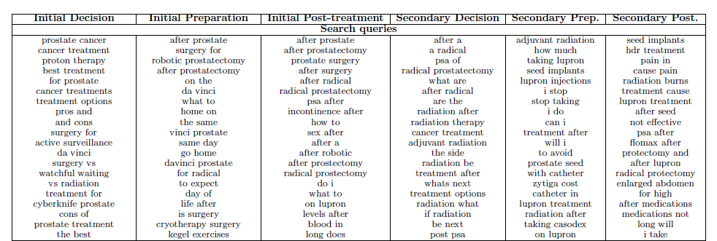
Phrase Characterization

Slide 14
Progression of Phases
Understand temporal patterns across all phases
  What does the “average” timeline look like?
No single user searched all phases, but we can stitch these together
  Computed multiple sequence alignment of the timelines

Slide 15
Multiple Sequence Alignment (MSA)
A
C
A
G
C
C
A
C
T
A
G
G
C
A
A
G
T
G
G
A
Want to align sequences of symbols based on similarity
Score based on how well symbols align, penalizing gaps and mismatches
  Want to pick alignment with highest score
Commonly used to align biological sequences
  A lot of software exists that we can use off the shelf

Slide 16
Multiple Sequence Alignment (MSA)
A
C
A
G
C
C
Our version:
Each timeline is a sequence
Each phase label is a symbol (6 total)
Special symbol for start of timeline (to encourage beginnings to align)
A
C
T
A
G
G
C
A
A
G
T
G
G
A
Want to align sequences of symbols based on similarity
Score based on how well symbols align, penalizing gaps and mismatches
  Want to pick alignment with highest score
Commonly used to align biological sequences
  A lot of software exists that we can use off the shelf

Slide 17
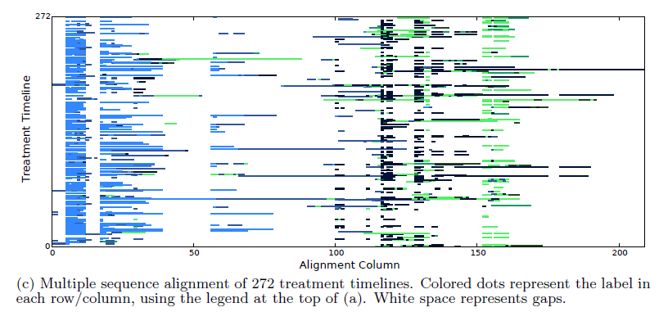
MSA of Treatment Timelines
Dominated by Initial Phases
Dominated by Secondary Phases
Initial post-treatment and secondary decision phases often interleaved

Slide 18
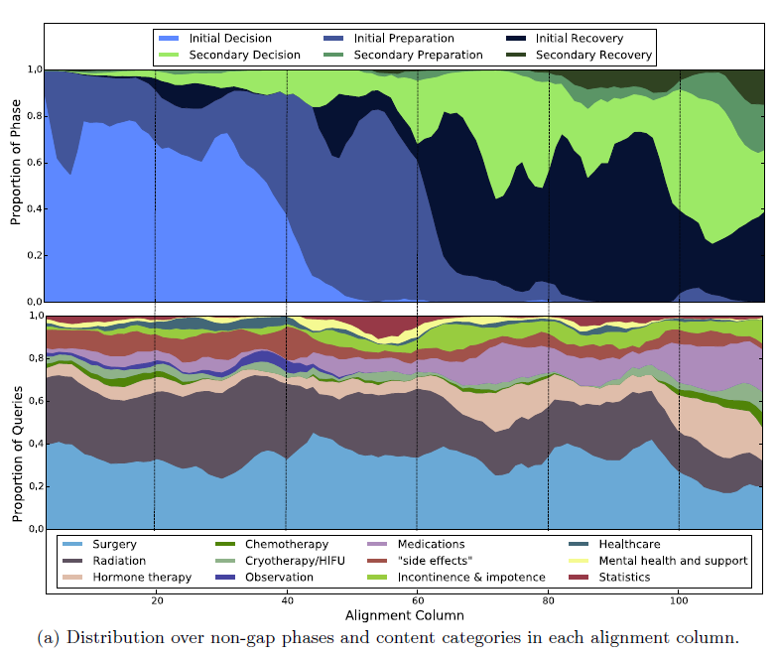
Phase Distribution
More clearly see phase
progression over time
Do this by:
  Removing gaps from each
  column
  Excluding columns with < 10
  non-gap symbols
Computed distribution of
categories over time
Patterns, e.g.,
  Hormone and prostate cancer
  medications increase over time
  General interest
  in side effects
  Specific
  concerns
  →
Notes:
Manually curated ontology of terms of interest
4-level hierarchy including terms related to screening, diagnosis, staging and grading

Slide 19
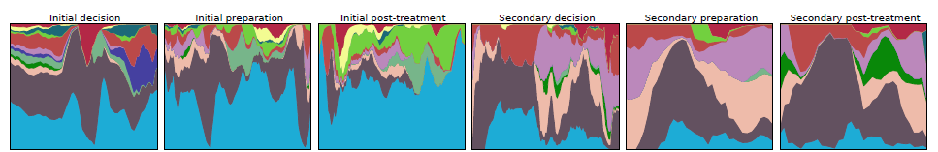
Content Distribution within Treatment Phase
Computed content distribution within each of the treatment phases
Only excluded non-gap values (no minimum)
Differences per phase, e.g.,
  Searches for healthcare appear mostly in initial decision phase
  Searches for mental health appear mostly in the initial post-treatment phase
  More reference to surgery in initial; more to hormone/chemotherapy in secondary

Slide 20
Analyzing Treatment Decisions
Want to understand the sequential patterns of information-gathering about treatments and outcomes during decision making
Focus on “initial decision” phase
Target
  Number and Specificity of Treatments
  Treatment Comparisons

Slide 21
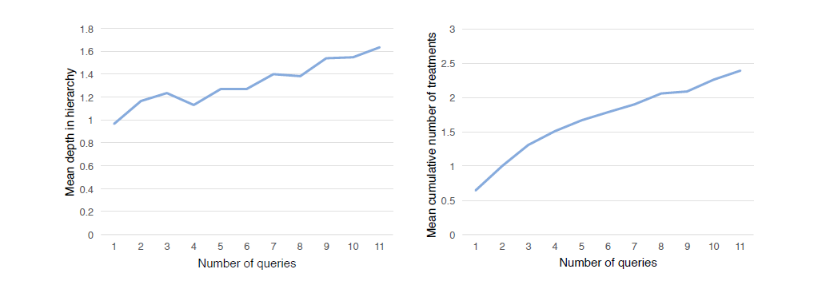
Number and Specificity of Treatments
Analyze average depth of treatments (in hierarchy) and average number of different treatments searched
Specificity of treatments over time
during initial decision phase
Cumulative number of different treatments
searched over time by average user
Notes:
Seek to understand progression of treatment-related searches

Slide 22
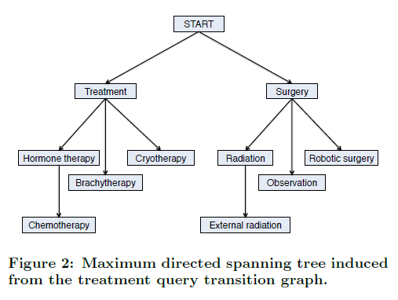
Transitions among Treatments
Examined transition structure by
comparing consecutive queries
  Better understand query refinement
  during exploring
Broken down as:
  68.8% of time, same treatment
  as previous query
  12.7% of time more specific
  9.5% of time more general
  9.0% of time different branch
Built query transition graph →
Better understand which treatments are searched after an initial treatment
Notes:
also in “initial decision” phase

Slide 23
Treatment Comparisons
Analyzed queries with multiple treatments in the same query
Likely to have a comparative intent (e.g., “surgery vs radiation”)
9.6% of initial decision queries contain multiple treatments
43.6% of (272) users issued such queries
Broken down as:
  Surgery and radiation (75%)
  Different types of surgery (7.3%)
  Surgery and observation (7.3%)
  Radiation and hormone therapy (6.3%)
  Different types of radiation (4.2%)
65.3% for most general terms
(e.g. “surgery vs radiation”)
34.7% for specific types
(e.g. “robotic surgery or seed implants”)

Slide 24
Summary
Analyzed timelines of prostate cancer searchers seeking treatment info.
  Identified clear temporal patterns and shifting interests / foci over time
Search engines need to better serve as decision support systems
  E.g., searcher making a decision may benefit from comparison support
Next step:
  Obtain additional context that affects information searching
  Engage direction with patients and understand their clinical situations
Other directions: Adapt methods to other illnesses, improve search and retrieval for other healthcare needs, e.g., selecting care providers

Slide 25
Thank you!

