Slide 1
Supporting Synchronous Social Q&A Throughout the Question Lifecycle
Matthew Richardson
Ryen White
Microsoft Research

Slide 2
Question Answering (Q&A)
People have questions, want answers
Automatic question answering not yet practical
  Complex questions
  Opinion questions
  Knowledge that is not written down
Solution: get others to help you out…

Slide 3
Social Question Answering
Also known as “Community Question Answering”
Ask people for help
  Send email to mailing list
  Use web forum
  Answers service (Yahoo! Answers)
Downsides:
  Spams a lot of people (mailing lists)
  Slow response (web forums)
Solution: use instant messaging…

Slide 4
Synchronous Social Question Answering
Users ask a question using instant messaging (IM)
System forwards question to users likely to know answer
  Forwards to a few at a time
Once a willing answerer is found, asker and answerer engage in dialog
Systems
  IM-an-Expert: Built and deployed within Microsoft
  Aardvark: Deployed on the Web
This paper uses IM-an-Expert for experiments
  But similar results are expected for Aardvark or other systems

Slide 5

IM-an-Expert: Real Time Social Q&A
Built and deployed within Microsoft, thousands of users
Free and available for any organization to install
  Shipped by
  Download at www.imanexpert.net

Slide 6
IM-an-Expert: Real Time Social Q&A
Built and deployed within Microsoft, thousands of users
Free and available for any organization to install
  Shipped by
  Download at www.imanexpert.net
Low latency (3 minutes median time to answer)
  (vs. 30 minutes for mailing lists, 3 hours for forums)
Low Interruption cost (10 users median num interrupted)
Excellent answer quality (4.5 average rating on 1-5 scale)

Slide 7
IM-an-Expert: Real Time Social Q&A
Built and deployed within Microsoft, thousands of users
Free and available for any organization to install
  Shipped by
  Download at www.imanexpert.net
Low latency (3 minutes median time to answer)
  (vs. 30 minutes for mailing lists, 3 hours for forums)
Low Interruption cost (10 users median num interrupted)
Excellent answer quality (4.5 average rating on 1-5 scale)
What can we do to support askers and answerers?

Slide 8
IMX System

Slide 9

IMX Sample Conversation 1/2

Slide 10
IMX Sample Conversation 2/2

Slide 11
Some Example Questions
Question | Rating
1. What is Unified Communications? | 5
2. Is Veterans Day a Microsoft holiday? | 5
3. Excel: how do I set default pivot table to “Classic”? | 5
4. OCS TCP UDP question | 5
5. Can DPM backup based on VSS writer services? | 1
6. Excel related: is there a way to have the "Classic PivotTable" as default in Excel 2007? When I create new pivots I have to go to "PivotTable Options" and then "Display" to change it to classic... I just don't like the "new" pivot format, so I use the classic all the time. Thanks. | 1
7. What is the capital city of Afghanistan | 1
8. I have a problem | 1

Slide 12
Supporting the Question Lifecycle

Slide 13
Supporting the Question Lifecycle
Will someone try to answer this question?
How many users will be interrupted?
Will the asker be satisfied with the answer?
Predicting:

Slide 14
Supporting the Question Lifecycle
Conception:
Is now a good time to ask a question?
Question Asked:
Is the question well phrased?
Do users know this topic?
Are people available?
What kind of question is it?
Answerer Found:
Does this user know this topic?
Dialog:
How is the dialog going?
Post-Dialog:
Was the question eventually answered?
Will someone try to answer this question?
How many users will be interrupted?
Will the asker be satisfied with the answer?
Predicting:

Slide 15
Method
Goal
  Predict satisfied, answered, and num interruptions
Data
  1725 questions from IM-an-Expert use
  1009 questions were answered
  794 were rated
Technique
  Classification: Logistic regression with L1 and L2 regularization
  Regression: Linear model, stochastic grad. descent, squared loss
  10-fold cross-validation
  Relatively small data set: Boosted decision trees and averaged perceptron gave no better results.

Slide 16
Prediction Task: Features
Conception (49 features)
  Asker: Profile size, anonymity, max per day, …
  Time: hour, day, avg. availability
Asked (22)
  Question: type, ‘help’, ‘please’, newlines, length,…
  Potential Answerers: expertise scores, availability
Answerer Found (29)
  Answerer: Profile size, anonymity, max per day, …
  Answerer profile match with question, time elapsed
Dialog (26)
  Time elapsed, turns by each user, chars typed
  “sorry”, “don’t know”, “I don’t”, “thank you”
  URLs, question marks, emoticons

Slide 17
Availability
Traditional work day

Slide 18
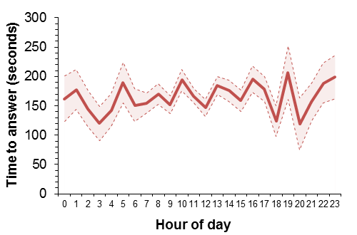
Availability
Traditional work day

Slide 19
Just for Fun: Fine-grained Availability

Slide 20
Results for Satisfied, Post-Dialog
Predict rating of 3 or more

Slide 21
Results for Satisfied
Predict rating of 3 or more

Slide 22
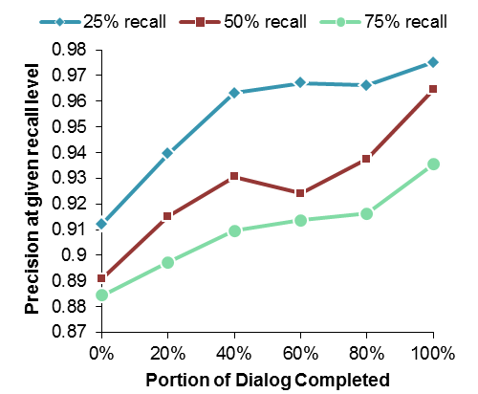
Predicting Satisfied During the Dialog

Slide 23
Dissatisfied (rating < 3)

Slide 24
Feature Selection for Satisfied

Slide 25
Other Tasks
Answered
Interruptions

Slide 26
Supporting Askers and Answerers
How can this support askers?
  Inform asker of satisfaction or answer probability
    Asker can rephrase or go elsewhere if too low
How can this support answerers?
  Abort questions that are unlikely to be answered
    Saves 45 answerers from receiving an interruption
  Abort questions that are unlikely to satisfied
  Force asker to rephrase questions that will cause many interruptions
  Build knowledge base of satisfied questions even if there was no rating, which takes load off of answerers.

Slide 27
Conclusions
Synchronous social Q&A a valuable technique
  Faster response times, less answerers interrupted, high satisfaction
Answerers are volunteers: Want to reduce their load
Askers expect quick, quality answers: Inform when otherwise
Explored prediction tasks for satisfied, answered, num interrupted to support askers and answerers.
Used data from real system (IM-an-Expert)
  System is available at imanexpert.net
Able to achieve our tasks with reasonable accuracy
  Particularly at lower levels of recall
Results should extend to any synchronous social Q&A system

