Slide 1
Predicting User Interests from Contextual Information
Ryen W. White, Peter Bailey, Liwei Chen
Microsoft Corporation

Slide 2
Motivation
Information behavior is embedded in external context
Context motivates the problem, influences interaction
IR community theorized about context
Context sensitive search, user studies of search context
User interest models can enhance post-query behavior & general browsing by leveraging contextual info.
e.g., personalization, information filtering, etc.
Little is known about the value of different contextual sources for user interest modeling

Slide 3
Overview
A systematic, log-based study of five contextual sources for user interest modeling during Web interaction
Assume user has browsed to URL
Evaluate the predictive value of five contexts of URL:
Interaction: recent interactions preceding URL
Collection: pages that link to URL
Task: pages sharing search engine queries with URL
Historic: long term interests of current user
Social: combined long-term interests those who visit URL
Domain is website recommendation not search results

Slide 4
Data Sources
Anonymized URLs visited by users of a widely-distributed browser toolbar
4 months of logs (Aug 08 – Nov 08 inclusive):
Past: Aug-Sep used to create user histories
Present: Oct-Nov used for current behavior and future interests
250K users randomly selected from a larger user pool once most active users (top 1%) were removed
Chosen users with at least 100 page visits in Past

Slide 5
Trails and Terminal URLs
From logs we extracted millions of browse trails
Temporally-ordered sequence of URLs comprising all pages visited by a user per Web browser instance
Terminate with 30-minute inactivity timeout
A set of 5M terminal URLs (u_{t}) obtained by randomly-sampling all URLs in the trails
Terminal URLs demarcate past and future events
Task = Learn user interest models from contexts for u_{t}, use those models to predict future user interests

Slide 6
Building User Interest Models
Classified context URLs in the Open Directory Project human-edited Web directory (ODP, dmoz.org)
Automatically assigned category labels via URL match
URL back-off used if no exact match obtained
Represent interests as list of ODP category labels
Labels ranked in descending order by frequency
For example, for a British golf enthusiast, the top of their user interest profile might resemble:
ODP Category Labels Frequency
Sports/Golf/Courses/Europe/United Kingdom 102
Sports/Golf/Driving Ranges 86
Sports/Golf/Instruction/Golf Schools 63

Slide 7
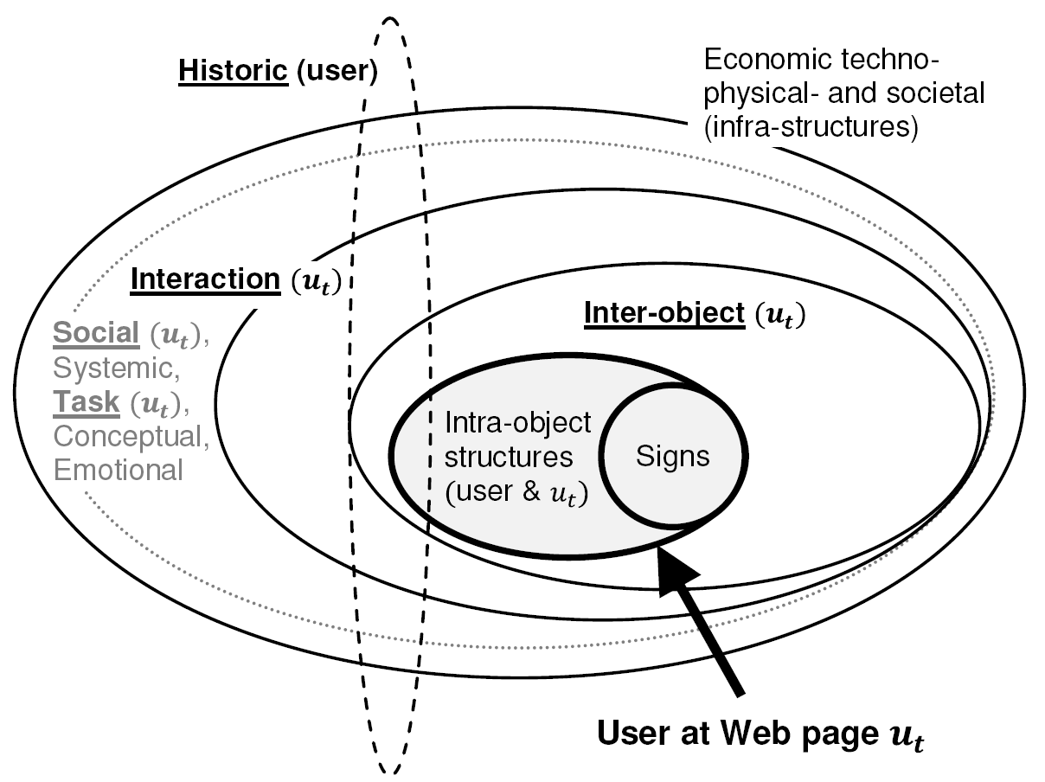
Selecting Contexts
Ingwersen and Järvelin (2005) developed nested model of context stratification representing main contextual influences on people engaged in information behavior
Dimensions used
Others challenging to model via logs
e.g., cognitive and affective state, infra- structures, etc.

Slide 8
Defining Contexts
None (u_{t} only): Interest model for terminal URL
Interaction (u_{t-5} … u_{t-1}): Interest model for five Web pages immediately preceding u_{t}
Task: Interest model for pages encountered during the same or similar tasks
Walk on search engine click graph from u_{t} to queries and then back out to pages

Slide 9
Defining Contexts
Collection: Interest model pages linking to u_{t}
We obtained a set of in-links for each u_{t} from a search engine index, built model from pages linking to u_{t}
Historic: Interest model for each user based on their long-term Web page visit history
Social: Interest model from combination of the historic contexts of users that also visit u_{t}
What is the effectiveness of different context sources for user interest modeling?

Slide 10
Methodology
Found instances of u_{t} in Present set (Oct-Nov 08 logs)
Used all actions after u_{t} as source of future behavior
Futures specific to each user and each u_{t}
Used to gauge predictive value of each context
Created three interest models representing future interests (ranked list of ODP labels & frequencies):
Short: within one hour of u_{t}
Medium: within one day of u_{t}
Long: within one week of u_{t}
Filtered {u_{t}} to help ensure experimental integrity
e.g., no more than 10 u_{t} per user

Slide 11
Methodology
Divided filtered {u_{t}} into 10 equally-sized runs
Each run contained at most one u_{t} from each user
Experimental procedure:
For each u_{t} in each run:
Build ground truth for short-, medium-, and long-term future interest models
Build interest models for different contexts (and combinations)
Determine predictive accuracy of each model
Used five measures to determine prediction accuracy
P@1, P@3, Mean Reciprocal Rank, nDCG, and F1
F1 tracked well with others - focus on that here

Slide 12
Findings – Context comparison
Predictive performance of contextual sources for different futures
Interaction context & Task context most predictive of short-term interests
Task context most predictive of medium-term interests
Historic context most predictive of long-term interests

Slide 13
Findings – Handling near misses
Near miss between prediction and ground truth regarded as total miss
Use one/two/three-level back-off on both ground truth and prediction
Back-off to top two ODP levels
No back-off

Slide 14
Findings – Improved confidence
Basing predictions & ground truth on small # page visits may skew results
Repeat experiment & ignore labels based on < 5 page visits
Predicted and ground truth labels based on ≥ 5 pages
No back-off

Slide 15
Findings – Combining contexts
Rank | Short |  | Medium |  | Long
 | Sources | F1 score | Sources | F1 score | Sources | F1 score
1 | n, i, t, h, s, c | 0.72** | n, i, t, h, s, c | 0.53** | n, i, t, s, h, c | 0.45**
2 | n, i, s, h, c | 0.71** | n, i, t, h, c | 0.52** | n, i, s, h, c | 0.43**
3 | n, i, t, h, c | 0.71** | n, i, t | 0.49** | n, i, t, h, c | 0.43*
4 | n, i, h, c | 0.71** | n, i, s, h, c | 0.48* | s, h | 0.43*
5 | n, i, s, t, c | 0.69** | n, i, h, t | 0.48* | n, i, s, h, t | 0.42*
Overlap beats single contextual sources
Key contexts still important
Short = Interaction (i) and Task (t)
Medium = Task (t)
Long = Historic (h)
Supports polyrepresentation theory (Ingwersen, 1994)
Overlap between sources boosts predictive accuracy

Slide 16
Summary of Findings
Performance of context dependent on distance between u_{t} and end of prediction window
Short-term interests predicted by task/interaction contexts
Topical interest may not be highly dynamic, even if queries and information needs are
Medium-term interests best predicted by task context
More likely to include task variants appearing in next day
Long-term interests predicted by historic/social contexts
Interest may be invariant over time, users visiting same pages may have similar interests
Overlap effective - many contexts reinforce key interests

Slide 17
Conclusions and Take-away
Systematic study of context for user interest modeling
Studied predictive value of five context sources
Value varied with duration of prediction
Short: interaction/task, Medium: task, Long: historic/social
Overlap was more effective than any individual source
Source must be tailored to modeling task
Search/recommendation systems should not treat all contextual sources equally
Weights should be assigned to each source based on the nature of the prediction task

