Slide 1
Effects of Community size and contact rate on synchronous SOCIAL Q&A
Ryen W. White
Microsoft Research
Matthew Richardson
Microsoft Research
Yandong Liu
Carnegie Mellon University

Slide 2
Question Answering (Q&A)
People have questions, want answers
Automatic question answering not yet practical
Complex questions
Opinion questions
Knowledge that is not written down
Solution: get others to help you out…

Slide 3
Social Question Answering
Also known as “Community Question Answering”
Ask people for help
Send email to mailing list
Use web forum
Answers service (Yahoo! Answers)
Downsides:
Spams a lot of people (mailing lists)
Slow response (web forums)
Solution: use instant messaging…

Slide 4
Synchronous Social Question Answering
Users ask a question using instant messaging (IM)
System forwards question to users likely to know answer
Forwards to a few at a time
Once a willing answerer is found, asker and answerer engage in dialog
Example systems
Aardvark: Deployed on the Web (contacts friends, FoF, etc.)
IM-an-Expert: Built and deployed within Microsoft (contacts “experts”)
Others in CSCW and CHI community
This paper uses IM-an-Expert for experiments
But similar results are expected for Aardvark or other systems
Notes:
Link to experiments

Slide 5
IM-an-Expert
Facilitates question answering via real-time IM dialog
All users are “experts” - can ask and answer questions
IM-an-Expert finds answerers, connects askers to them, and mediates dialog:
Asker poses question via IM or a Web page
IM-an-Expert finds best available answerer
Proxies IM conversation between asker and answerer

Slide 6
IMX Sample Conversation (1 of 2)

Slide 7
IMX Sample Conversation (2 of 2)

Slide 8
Expert Finding
Sources of user information
Implicit
Emails sent to internal distribution lists
Explicit
User-provided keywords and URLs about themselves or their interests
TF.IDF ranking with temporal decay to balance questions
Profile page where users can also:
Set question limits
Tune privacy settings
Suspend or disable the service

Slide 9
Dialog Management
Coordinates flow of messages between askers/answerers
Contacts top-k experts
k is “contact rate”
Only asks those who are Available
Availability set from calendars and users could set manually
If answerer doesn’t respond in 60 seconds or types “no”, then contact next user in list
Once answerer accepts, other invitations are canceled
All IM dialog logged
Notes:
Better introduce contact rate

Slide 10
Asker and Answerer needs in IMX
In IM-an-Expert, all users can ask and answer questions
Needs are in tension
E.g., to get low time to answer may need to interrupt many users
Investigate effect of community size and contact rate on the extent to which these needs can be satisfied
This can help us:
Understand the impact of these factors in synchronous Q&A
Design better social Q&A systems
Askers want | Answerers want
Low time-to-answer | Few interruptions
Quality answers | Relevant questions

Slide 11
User Study: Participants
Participants and Recruitment
Redmond-based MSFT employees w/ mailing-list based profiles ≥ 1kb
Users required to be available for two-week study duration
402 volunteers in total, users were highly familiar with IM (4.5/5)
Experimental Groups:
6 groups, varying both community size (n) and contact rate (k)
Group members didn’t know about the other groups
n

Slide 12
User Study: Methodology
Study lasted two weeks
Asked participants to take a pre-experiment survey
Randomly-assigned participants to experimental group
Asked participants to visit their profile page and provide keywords and URLs describing interests and expertise
Re-indexed daily to capture any profile updates
Participants asked to consider using IM-an-Expert as resource for answering questions for study duration
Two weeks from start date, study ended and participants completed post-experiment survey
70% of all participants did so
Attrition was spread evenly across groups

Slide 13
Findings: General Usage
Around 50% of participants asked and answered questions in the two-week study (35% of users did both)
25% of participants asked/answered half the questions
Dialogs:
Lasted around six minutes
Comprised around 10 dialog turns
Turns evenly distributed between askers and answerers

Slide 14
Recall from earlier
We’re going to look at each of these needs in more detail
Askers want | Answerers want
Low time-to-answer | Few interruptions
Quality answers | Relevant questions

Slide 15
Findings: Asking – Time to Answer
Key takeaways:
Doubling group size leads to 30s reduction in time to answer
Higher contact rate leads to lower time to answer
Notes:
Statistically significant?

Slide 16
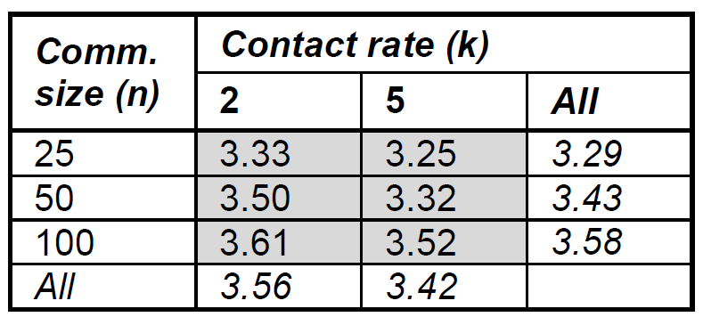
Findings: Asking – Answer Ratings
Askers rate answers on a scale from 1-5 at end of dialog
Key takeaways:
Larger group size leads to higher answer ratings (more expertise)
Higher contact rate leads to lower answer ratings
Less expert answerers may respond before more expert answerers
Notes:
Remember that we had these four things …

Slide 17
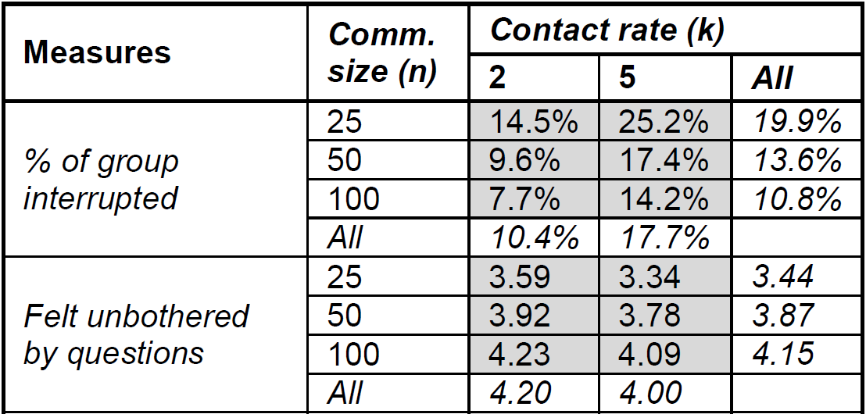
Findings: Answering – Interruptions
Median number of users interrupted per question = 6
Key takeaways:
Larger community size, less % interrupted + answerers less bothered
Higher contact rate, more % community interrupted + more bothered

Slide 18
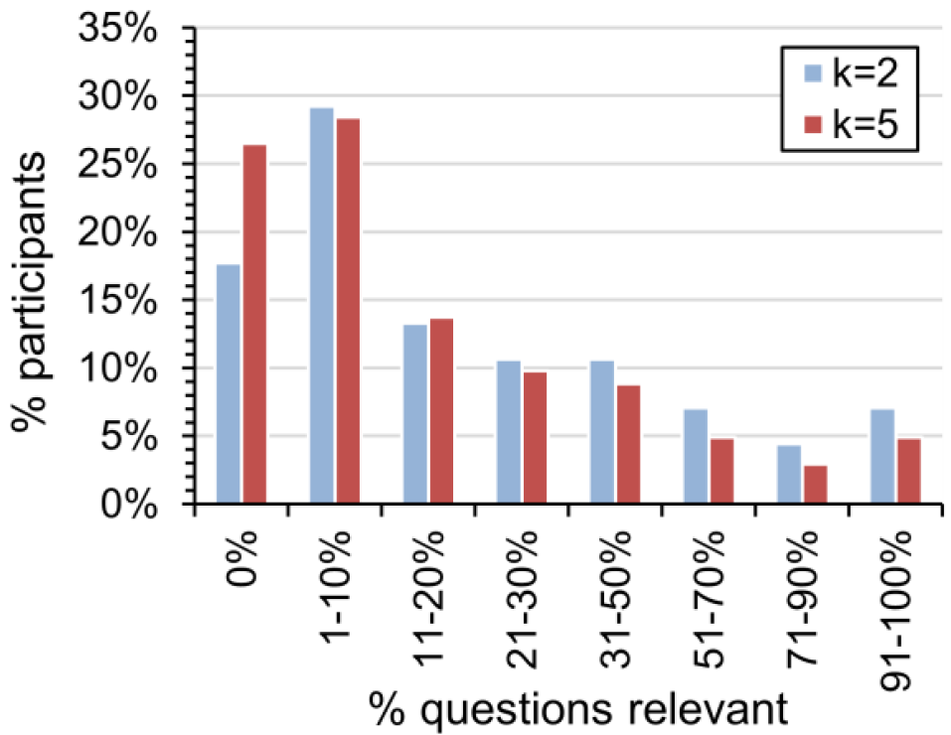
Findings: Answering – Relevance
Asked answerers:
Approximately what percentage of questions asked were relevant to you? (0, 1-10%, 11-20%, etc.)
k=2 more relevant than k=5
No differences from community size
Reasons for not answering:
Question wasn’t relevant to me (~25%)
I didn’t know the answer (~50%)
Expertise level is important in addition to having expertise

Slide 19
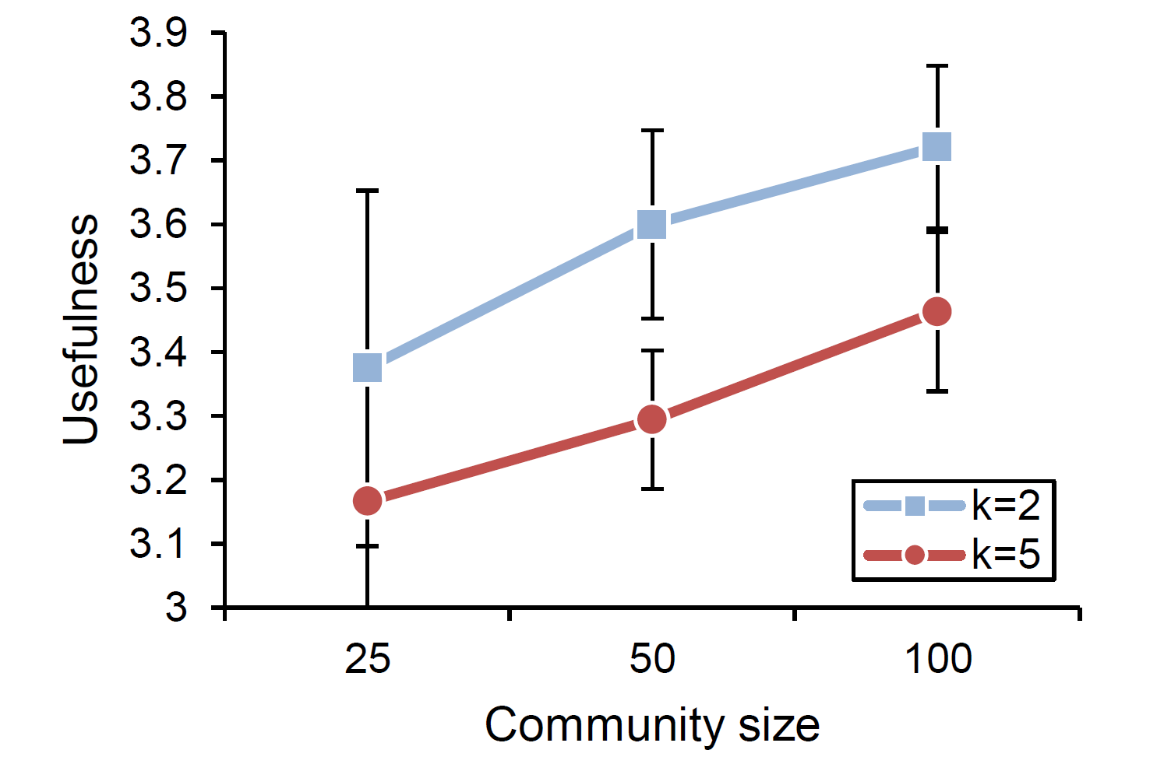
Findings: Overall Perceptions
k=5 meant more answers and more timely answers, but ...
k=2 was more useful
Users may wait longer for better answers, dislike interruptions
Notes:
More value on answer quality than speed. Logarithmic scale.

Slide 20
Conclusions
Download IM-an-Expert (http://imanexpert.net)
Investigated impact of community size and contact rate on the effectiveness of synchronous social Q&A
As community size grew, system performance increased
Contact rate:
Askers prefer k with timely answers (k=5), high quality answers (k=2)
Answerers prefer k with relevant questions, few interruptions (k=2)
To satisfy most users, synchronous social Q&A systems should use low contact rates and large communities
More research is needed on the answer quality vs. timeliness tradeoff e.g., ceiling effects as community size grows

