Slide 1
Experiences with Web Search on Medical Concerns and Self Diagnosis
Ryen W. White PhD and Eric Horvitz MD, PhD
Microsoft Research
{ryenw, horvitz}@microsoft.com

Slide 2
Outline
Motivation
Online Medical Search
Cyberchondria
Study
Research Questions
Methodology
Findings
Undiagnosed Conditions
Diagnosed Conditions
Implications

Slide 3
Online Medical Search
Healthcare websites for worried well
Provide valuable information, address concerns, etc.
80% US adults use search engines to find medical info
75% don’t verify quality (validity, date, etc.)
Problem: Search engines for diagnostic reasoning
Link to pages with alarming content
More written about serious than benign explanations
Ranking algorithms use click logs; reinforce alarming pages

Slide 4
Online Medical Search
Challenge: Linking to troubling scenarios in absence of likelihood information
Consumers seek confirmation and disconfirmation
Search engines relied upon for quality information but perform information retrieval rather than diagnosis
Likelihood information not considered in ranking of lists
Influence of signs & symptoms on likelihoods not provided
Search engines suffer from & fuel biases of judgment: base-rate neglect, availability, confirmation

Slide 5
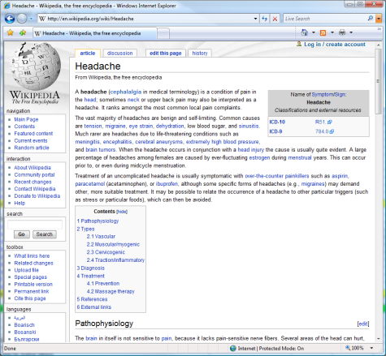
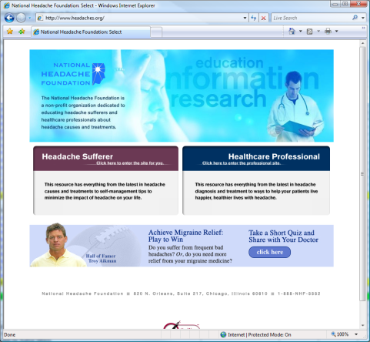
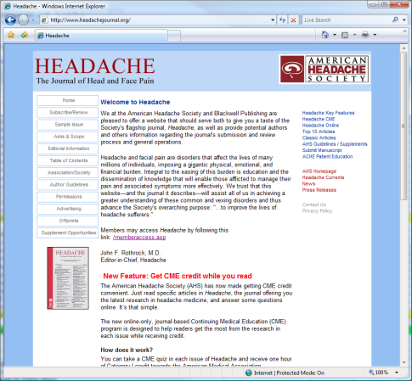
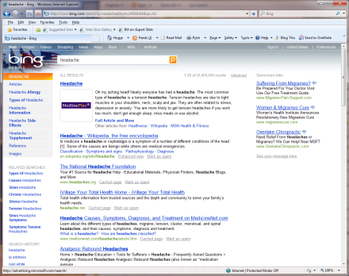
Cyberchondria
Unfounded escalation of concerns about common symptomology based on review of search results and literature online
❸ Browse Web pages
headache
❶ Query search engine for [headache]
❷ Review
results
brain tumor
❹ Query for [caffeine withdrawal]
❹ Query for [brain tumor] – Medical anxiety
caffeine withdrawal
Previous log analyses - cyberchondria common; lacked qualitative data

Slide 6
Study: Overview & Objectives
Survey of experiences with Web use for self diagnosis
Considered diagnosed & undiagnosed conditions
Research Questions:
What are characteristics of Web-based medical diagnosis?
Are these characteristics associated with age or gender?
What are key dependencies among characteristics?
Prior studies have not answered these questions
Self-report data from 500+ volunteers within Microsoft

Slide 7
Methodology
Survey designed to elicit:
Perceptions of online medical information
Experiences in searching for this information
Influence of the Web on healthcare concerns & interests
Anonymized. 70 open & closed questions
Covered health issues, including medical history & engagement with health professionals
Five-point scales used to measure frequency:
Always | Often | Occasionally | Rarely | Never

Slide 8
Findings: Background
350 males, 165 females; median age = 36 years
Most used search engines to find medical information
5-10 medical searches/month - medical domain novices
4% self-identified as “hypochondriac”
5 times average number of medical searches
Subjects had low level of medical anxiety (3 on 10 pt scale)
3/4 of subjects searched for medical symptoms
2/3 searched for undiagnosed cond. at least once/month
Subjects generally searched for themselves
Women on behalf of relatives more than men (66% vs. 53%)
Notes:
Women on behalf of relatives more than men (66% vs. 53%)
What is the confidence level – perhaps say this during the presentation.

Slide 9
Findings: Undiagnosed Conditions
Question |  | Group
 |  | All | Male | Female
How often do your Web searches for symptoms / basic medical conditions lead to your review of content on serious illnesses? | % Always or Often | 21.1 | 19.3 | 25.0
Has searching for health-related information online ever made you feel more anxious about a perceived medical condition? | % Yes | 38.5 | 35.4 | 45.2
Has searching for health-related information online ever made you feel less anxious about a perceived medical condition? | % Yes | 50.3 | 49.6 | 51.7
Does searching the Web for health-related information make you behave differently with respect to a perceived medical condition? | % Yes | 39.2 | 38.9 | 39.9
χ² significance: p < .05, p < .01
20-25% of searchers escalate frequently
Main factors contributing to anxiety:
Mention of serious conditions (64%)
Escalatory terms (e.g., grave, fatal) (41%)
No benign explanations (36%)
Main factors reducing anxiety:
Authoritative sources (90%)
Synthesis from multiple sources (48%)
Behavioral changes manifest as:
Searches for serious concerns increase (61%)
Visits to relevant Web sites increase (72%)
Engage. w/ medical specialists increase (60%)

Slide 10
Findings: Undiagnosed Conditions
Conditioning on answers to pivotal questions:
RankAsLikelihood (Always-Never): “If your queries contain medical symptoms, how often do you consider the rank of the Web search results as indicating the likelihood of illnesses, with more likely diseases appearing higher up on the result page(s)?”
Hypochondriac (Yes-No): “Do you think that you are a hypochondriac?”
OverThreshold (Yes-No): “Do you believe that you have ever been in a situation where Web content “put you over the threshold” for scheduling an appointment with a health professional, when you would likely have not sought professional medical attention if you had not reviewed Web content?”

Slide 11
Findings: Undiagnosed Conditions
Question |  | Group |  |  | RankAsLikelihood |  | Hypochondriac |  | OverThreshold
 |  | All | Male | Female | Always | Never | Yes | No | Yes | No
How often do your Web searches for symptoms / basic medical conditions lead to your review of content on serious illnesses? | % Always or Often | 21.1 | 19.3 | 25.0 | 28.4 | 14.8 | 43.8 | 20.3 | 36.9 | 16.2
Has searching for health-related information online ever made you feel more anxious about a perceived medical condition? | % Yes | 38.5 | 35.4 | 45.2 | 45.7 | 29.6 | 66.8 | 37.5 | 57.4 | 32.6
Has searching for health-related information online ever made you feel less anxious about a perceived medical condition? | % Yes | 50.3 | 49.6 | 51.7 | 37.4 | 64.3 | 31.9 | 51.0 | 36.3 | 54.7
Does searching the Web for health-related information make you behave differently with respect to a perceived medical condition? | % Yes | 39.2 | 38.9 | 39.9 | 78.6 | 32.2 | 66.7 | 38.2 | 58.2 | 33.3
χ² significance: p < .05, p < .01

Slide 12
Findings: Diagnosed Conditions
Question |  | Group
 |  | All | Male | Female
Did your use of the Web [for related medical searches] occur solely after your diagnosis? | % Yes | 26.8 | 28.3 | 23.6
Did the Web help reassure you? | % Yes | 76.0 | 72.6 | 83.3
Did the Web help you understand the terminology or explanation used by the health professional? | % Yes | 77.9 | 75.8 | 82.4
Did the information help you to actively participate in the conversation with the health professional? | % Yes | 64.9 | 63.2 | 68.5
~80% used Web to study diagnosed medical conditions
~60% informed physician
~15% felt uncomfortable bringing their own research to physician
Physician reaction (from patient’s perspective):
37% happy
51% neutral
5% discontent or irritated
7% could not interpret
χ² significance: p < .05, p < .01

Slide 13
Findings: Diagnosed Conditions
Question |  | Group |  |  | RankAsLikelihood |  | Hypochondriac |  | OverThreshold
 |  | All | Male | Female | Always | Never | Yes | No | Yes | No
Did your use of the Web [for related medical searches] occur solely after your diagnosis? | % Yes | 26.8 | 28.3 | 23.6 | 14.3 | 36.5 | 9.4 | 27.4 | 17.5 | 29.7
Did the Web help reassure you? | % Yes | 76.0 | 72.6 | 83.3 | 69.8 | 68.1 | 50.0 | 76.9 | 70.8 | 77.6
Did the Web help you understand the terminology or explanation used by the health professional? | % Yes | 77.9 | 75.8 | 82.4 | 78.6 | 76.5 | 83.3 | 77.7 | 82.0 | 76.6
Did the information help you to actively participate in the conversation with the health professional? | % Yes | 64.9 | 63.2 | 68.5 | 64.3 | 51.3 | 83.3 | 64.2 | 79.6 | 60.3
χ² significance: p < .05, p < .01

Slide 14
Findings: Summary
Presented findings of survey of participants’ experiences with investigating medical concerns & performing self-diagnosis
Escalation reported to occur frequently for 20% subjects
Web increases anxiety (40% people), reduces (50% people)
Web can help, but can also cause distress, especially for those that are pre-disposed to anxiety
Key marginalizations revealed larger effects
Web plays a key role in helping patients understand conditions before and after diagnosis

Slide 15
Implications
Content providers & search engine designers should be aware of their influences on consumers
Caution with alarming content linked to common symptoms
Additional context (e.g., predispositions, likelihoods, incidence)
Dependable ways to investigate medical info online
Web content facilitates patient-physician interaction
Receptiveness to patient research by clinicians
Investigate ways to combine patient-driven research and professional advice to improve care provided
Periodic surveys and analysis with different cohorts
Opportunities for ongoing tracking of health experience with web search and browsing
Track changes in goals, perceptions, activities, outcomes

