Slide 1
Assessing the Scenic Route: Measuring the Value of Search Trails in Web Logs
Ryen W. White, Microsoft Research Jeff Huang, University of Washington

Slide 2
Overview
IR focuses on effectively ranking documents
Individual pages may be inadequate for complex needs
Trails are a series of pages starting with a query and terminating with session inactivity
Little is known about the value that trails bring to users
Estimate the benefit of trail following behavior
Know if/when useful ➔ Build trail-centric IR systems

Slide 3
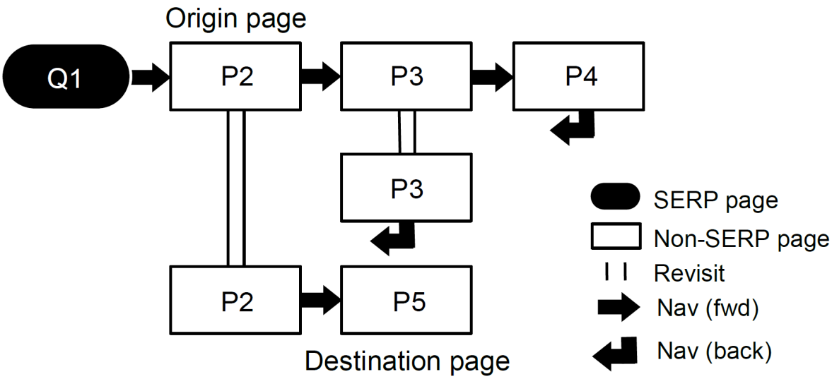
Trails and Sources
SERP = Search Engine Result Page
Full-trail =
Origin = First page in trail (visited from result click)
Destination = Last page in trail
Sub-trail = All trail pages other than destination
We compare the value of these sources for Web search

Slide 4
Outline for Remainder of Talk
Related Work
Study
Research Questions
Trail Mining and Labeling
Metrics
Method
Findings
Implications
Summary

Slide 5
Related Work
Trails
Trailblazing users create links between docs (Bush, 1945)
Destinations
Teleportation (Teevan et al., 2004; White et al., 2007)
Information-seeking strategies
Orienteering, berrypicking, information foraging, etc.
Guided tours (hypertext community)
Human generated (Trigg, 1988)
Automatically generated (Guinan & Smeaton, 1993)

Slide 6
Research Questions
Which sources (origin, destination, sub-trail, full-trail):
Provide more relevant information? (𝑅𝑄1)
Provide more topic coverage? (𝑅𝑄2)
Provide more topic diversity? (𝑅𝑄3)
Provide more novel information? (𝑅𝑄4)
Provide more useful information? (𝑅𝑄5)
Answers help us understand the value of trail following compared with viewing only origin and/or destination

Slide 7
Trail Mining and Labeling
Millions of trails were mined from MSN toolbar logs
March – May 2009, 100K unique users
Trails comprise queries and post-query behavior
Labeled trail pages based on Open Directory Project
Classification is automatic, based on URL with backoff
Coverage of pages is 65%, partial trail labeling is allowed
Normalized queries, trails ≥ 3 URLs, 10 trails/user max, …

Slide 8
Metrics
Relevance, Utility, Coverage, Diversity, Novelty
Per-source (origin, destination, sub-trail, full-trail)
Trails from May 2009 used for evaluation
Trails from March/April used for novelty metric (more later)
Metric values from sub-/full-trails may be larger than origins/destinations
Sub-trails / full-trails contain more pages
Extent of the difference important if we are going to show trails on the SERP (large benefit => support to include)

Slide 9
Metrics: Relevance/Utility
Relevance
6-pt Query-URL relevance scores from human judges
Average relevance score of sources
Utility
One if source has dwell time of 30 seconds or more
Supporting evidence from Fox et al. (2005)
… also Coverage, Diversity, and Novelty

Slide 10
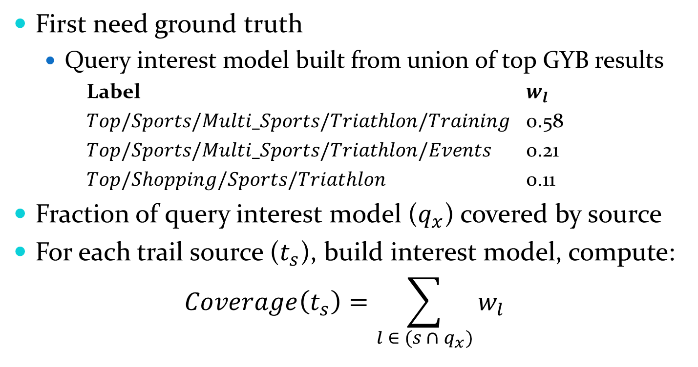
Metrics: Topic Coverage
First need ground truth
Query interest model built from union of top GYB results
Label $w_{l}$
$Top/Sports/Multi_Sports/Triathlon/Training$ 0.58
$Top/Sports/Multi_Sports/Triathlon/Events$ 0.21
$Top/Shopping/Sports/Triathlon$ 0.11
Fraction of query interest model ($q_{x}$) covered by source
For each trail source ($t_{s}$), build interest model, compute:
$$Coverage\left(t_{s}\right)=\sum_{l ∈ (s ∩ q_{x})}{w_{l}}$$

Slide 11
Metrics: Topic Diversity
Fraction unique query-relevant concepts from source
Same procedure as coverage
Build source interest model, compare w/ query model ($q_{x}$)
Fraction unique labels in $q_{x}$, not fraction of $q_{x}$
For each trail source $t_{s}$:
$$Diversity\left(t_{s}\right)=\sum_{l∈∈ (s ∩ q_{x})}{\frac{1}{|q_{x}|}}$$

Slide 12
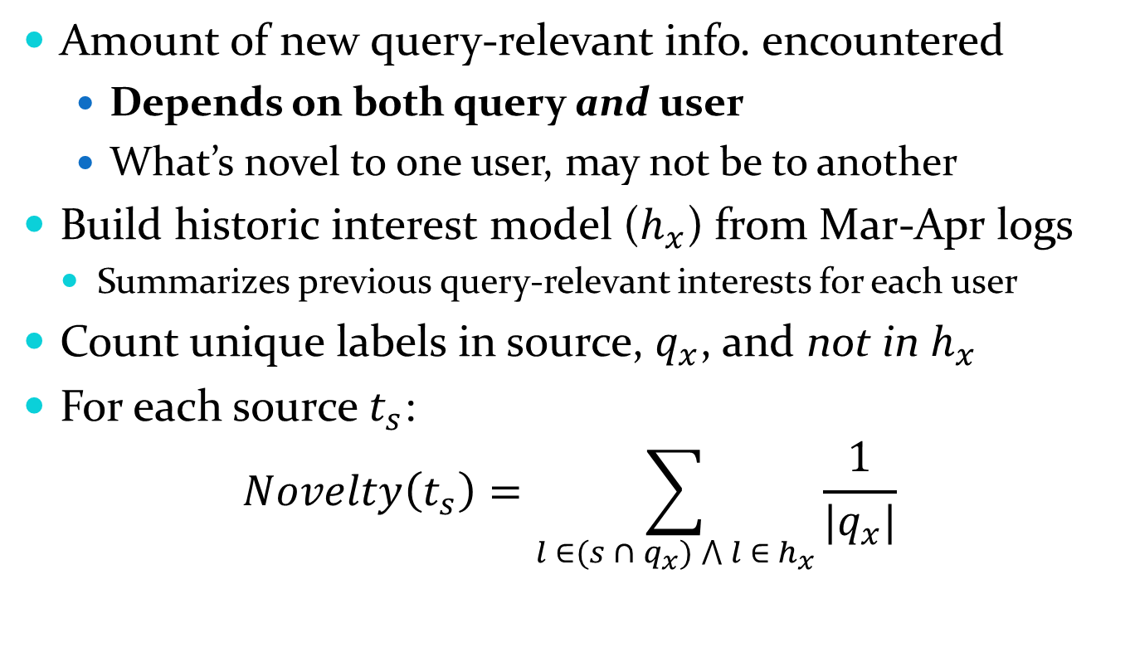
Metrics: Novelty
Amount of new query-relevant info. encountered
Depends on both query and user
What’s novel to one user, may not be to another
Build historic interest model ($h_{x}$) from Mar-Apr logs
Summarizes previous query-relevant interests for each user
Count unique labels in source, $q_{x}$, and not in $h_{x}$
For each source $t_{s}$:
$$Novelty\left(t_{s}\right)=\sum_{l ∈(s ∩ q_{x}) ⋀ l{ ∈ h}_{x}}{\frac{1}{|q_{x}|}}$$

Slide 13
Methodology
Construct query interest models 𝑄𝑥 based on set of 8K queries with human relevance judgments
Construct historic interest models for each user-query pair in Mar-Apr, filtered to only include queries appearing in 𝑄𝑥
For each search trail 𝑡 in 𝑇𝑥:
Assign ODP labels to pages all pages in 𝑡
Build source interest models for all sources
Compute relevance, coverage, diversity, novelty, utility
Average per query, and then average across all queries

Slide 14
Findings: All Queries
All differences significant at p < .01
Note: Normalized relevance scores to range from 0-1 for talk, not study

Slide 15
Findings: All Queries
Relevance is lower for trails
Users may be wandering to non-query relevant pages during the trail
Return to relevant destinations at the end of the trail
All differences significant at p < .01
Note: Normalized relevance scores to range from 0-1 for talk, not study

Slide 16
Findings: Query Popularity
Grouped queries into Low, Med, High popularity
Query popularity increase, metrics increase (all sources)
For example, for normalized relevance:
Re: relevance - engine performance improves w/ query popularity (see Downey et al., 2008)
Low popularity
Medium ($∆$ Low)
High ($∆$ Medium)

Slide 17
Findings: Query History
Effect of user “re-finding” on source value
Grouped queries into:
None: No instances for the user
Some: On average ≤ 30 instances in user history
Lots: On average > 30 instances in user history
Relevance, utility rise – users more familiar with topic
Coverage, diversity, novelty fall
Less variance in pages visited (see Tyler & Teevan, 2010)

Slide 18
Implications
Nature of query is important in source value
Popularity, history, … should be considered
Trails might be useful for supporting exploration
Trails might be a hindrance for focused tasks
How to select trails
Maximizing metrics presented in this talk?
Personalizing to user’s search history?
Recommend trails when destination unclear?
How and when to integrate trails into search results
Follow-up user studies and large-scale flights needed

Slide 19
Summary
Presented study estimating the value of trails to users
Systematically compare value of trails to other sources
Evaluation showed that trails provide significantly more coverage, diversity, novelty, etc. than pages
Findings vary by query popularity / re-finding
Next steps:
Investigate best-trail selection
See other SIGIR 2010 paper (Singla, White, Huang)
Incorporate trails into search engine result pages

