Slide 1
From Devices to People: Attribution of Search Activity in Multi-User Settings
Ryen White, Ahmed Hassan, Adish Singla, Eric Horvitz
Microsoft Research, USA; ETHZ, Switzerland
Contact: ryenw@microsoft.com

Slide 2
IDs in Behavioral Analysis @ Scale
Search engines use machine ids based on cookies etc.
Assume 1:1 mapping from ids (e.g., FDED432F901D) to people
However, multi-user computer usage is common
2011 Census data: 75% of U.S. households have a computer
In most homes that machine is shared between multiple people

Slide 3
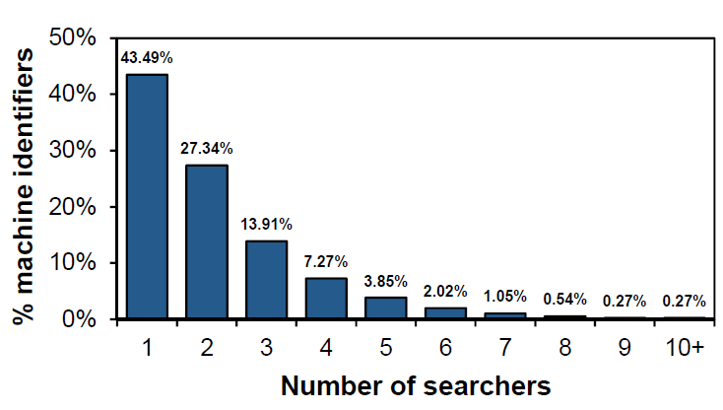
Multi-User Web Search
Analyzed two years’ of comScore search data (all engines, en-US)
Both machine identifiers and person identifiers (users self-identify)
Takeaway: 56% of machine ids comprise multi-user behavior
Multi-user (56%)

Slide 4
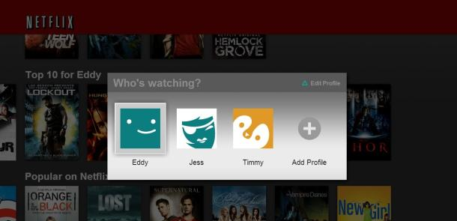
Handling Multiple Users
Limited current solutions in search engines (users can sign-in)
Some solutions in other domains, e.g., streaming media
Users can be asked to confirm identify (cumbersome), e.g.,
Our Focus: Can we do this automatically? (in context of search)

Slide 5
Activity Attribution Challenge
Given a stream of data from a machine identifier, attribute observed historic and new behavior to the correct person
Applications for: personalization, advertising, privacy protection
Related work in signal processing and fraud detection—hardly any related work in user behavior analysis
Research on “individual differences” in search activity is relevant
Historic behavior from machine id
New query
Which user?
User 1
User 2
User 1
User 3
{k user clusters}

Slide 6
Three parts to analysis
1. Characterizing differences in behavior from a machine given the presence of one user versus multiple users
2. Predicting:
Presence of multiple users (1 vs. N problem) (Classification task)
Estimating the number of users on a machine (Regression task)
3. Associating behavior to the correct user (via clustering in our case)
e.g., New query arrives, which user issued that query?
Focus on characteristics and prediction in this presentation

Slide 7
comScore Search Log Data
Two years of data (2011-2013)
Purchased data from comScore (non proprietary)
Summary statistics:
Person information per machine is ground truth

Slide 8
Characterization Are there within-id behavioral differences for one user vs. many?

Slide 9
Characterization
Characterize behavior observed from a machine identifier along a number of different dimensions:
Behavioral: # Queries, # Clicks, # Unique Query Terms, etc.
Temporal: Times machine used, Variations in time (hour, day)
Topical: Types of topics, Variation in topics of queries/clicks
Content: Nature of results viewed, inc. readability level

Slide 10
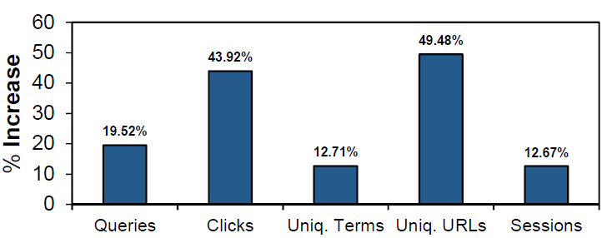
Behavioral Features
Increase in behavioral features for many users vs. single user
Much more search behavior when there are multiple users
- More searching and clicking, and diversity in queries/clicks
BUT some of this also applies to active searchers …

Slide 11
Temporal Features
Variance in time at which searches are issued, specifically:
- Day of week entropy - Time of day entropy
Large differences with varying numbers of searchers associated with searching on the machine

Slide 12
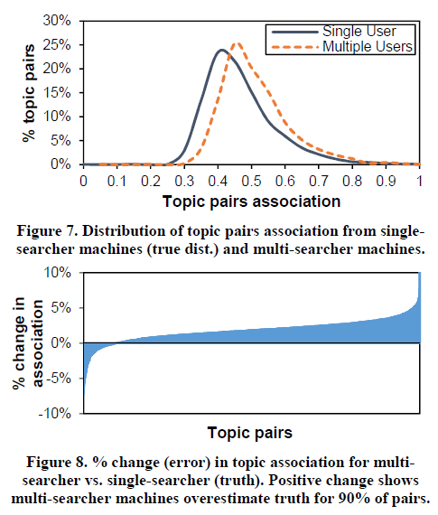
Topical/Content Features
Observed similar variations in entropy for topics and the readability of content
Topic pair (Ti, Tj) in 4-hr bucket
Topic association:
Multi-searcher machines overestimate topic associations for 90% of pairs

Slide 13
Prediction Can we predict multi-user ids?

Slide 14
Prediction
Two prediction tasks:
1. Classification task
Question: Is a machine identifier composed of multiple people?
2. Regression task
Question: If multiple users behind machine identifier, how many?
MART classification and regression
Use all features described so far
10-fold CV (at user level), 10 runs
Can chain models:
k‘ = 1
No
k > 1?
{Features}
Label
Yes
Regressor
Classifier
k'

Slide 15
Features and Labels
Features from the characterization:
Behavioral, Temporal, Topical, and Content
Plus Referential
Indications that there is likely to be another member of household, e.g., reference to spouse, child, roommate, etc. in queries
Labels:
Classification: Multi-user (1) vs. single user (0)
Regression: Number of users associated with machine id

Slide 16
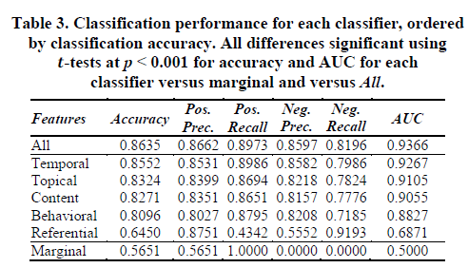
Classification: Results
Temporal features appear important for this task

Slide 17
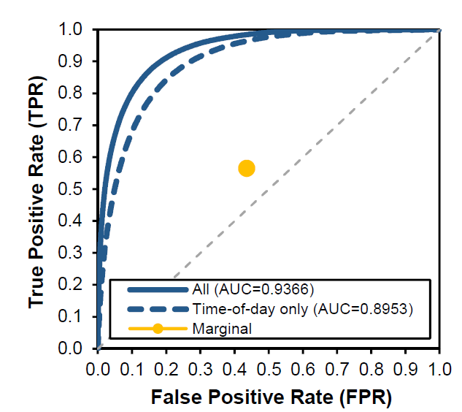
Classification: Time of Day ONLY
Variant that uses eight features that are only associated with the time of day only (e.g., hour bucket, bucket entropy)
Perf. similar to full model
Simpler to implement than the complete range of features highlighted earlier – 8 features vs 80!

Slide 18
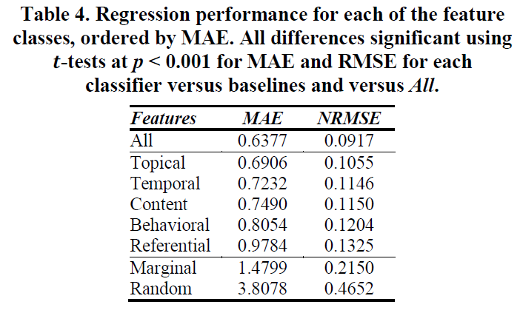
Prediction: Regression
Same features as for classification, different label
NRMSE =
RMSE/(k_{max} – k_{min})
Time-of-day features not as useful here (NRMSE=0.1300)

Slide 19
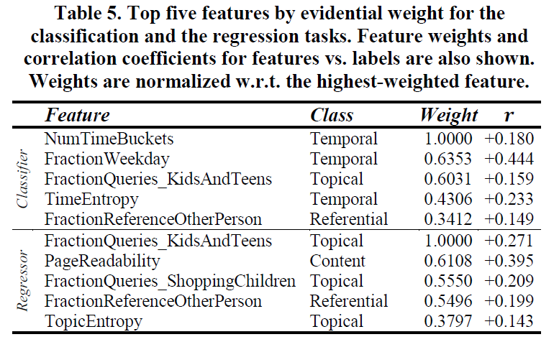
Top Features
Need the additional features for regression task
Features linked to children’s interests are important
Where there is a child, there is at least one adult (=> N ≥ 2)

Slide 20
Assignment Can we assign to correct user?

Slide 21
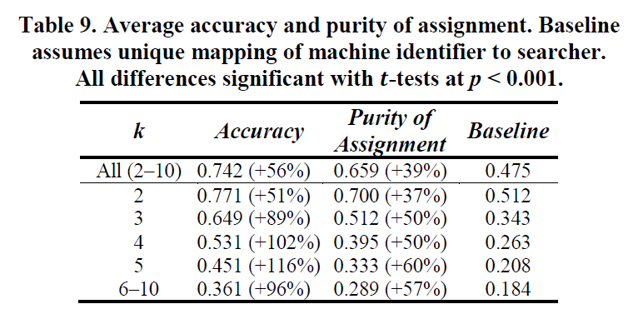
Assignment
Given the k’ from the regressor, run k-means clustering on the history from each machine identifier
Real-time assignment – given a user session:
Compare 1st query in session to cluster(s), assign to most similar
Compute similarity between session/cluster representative
Accuracy = proportion of assignments correct
Purity = proportion of assigned cluster to correct user
Baseline = one user

Slide 22
Discussion
comScore data based on self-identification (Errors? Not apparent)
Need to explore:
Utility of sign-in to search engines as proxy for person identifier
e.g.,
Different analysis timeframes (e.g., one month vs. two years)

Slide 23
Conclusions and Future Work
Introduced activity attribution challenge
Clear differences in logged behavior for one user vs. many
Possible to accurately:
1. Predict if multiple users are behind a machine id (AUC = 0.94)
2. Estimate number of users behind machine id (NRMSE = 0.092)
3. Assign queries to people (75% accuracy, 56% gain over baseline)
Future work: Apply methods to personalization, advertising, etc.

